Slide 1
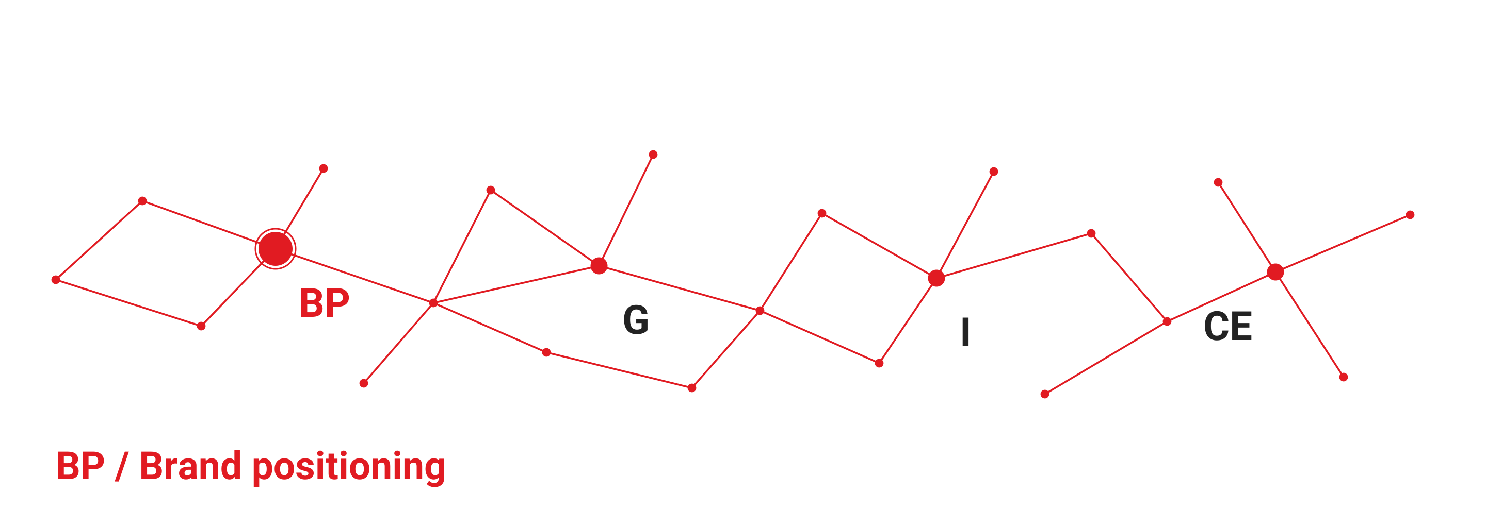
Brand positioning
[Client name]
WES GROUP / STRATEGY
Project brief and working approach
[Month Year]
Draft for discussion
Notes:
Working draft. Replace bracketed fields with approved project details. The sample methodology is not a statement of client facts or an agreed scope. Project focus: BP, Brand Positioning. The point-and-line motif is the WES identity visual approved for the brand showcase.

Slide 2
Project brief
01 / CONTEXT
Purpose
Establish a clear position for the brand in the markets it plans to serve.
The output should guide messaging, localised marketing and day-to-day decisions.
Inputs to confirm
Business objective and priority markets
Current offer, audience research and proof points
Decision owner, review process and scope
Notes:
Confirm the brief with the client before planning research. No market facts or commercial outcomes are assumed.

Slide 3
Audience and buying context
02 / AUDIENCE
Decision maker
What outcome do they need?
What makes an option credible enough to shortlist?
Users and advocates
What problem do they experience?
Which language and examples feel relevant in their market?
Approvers
Which risks need evidence?
Who reviews financial, legal or operational claims?
Working questions to validate through research and stakeholder interviews.

Slide 4
Positioning statement
03 / PROPOSITION
For [priority audience], [brand] provides [offer] that helps them [desired outcome].
The reason to believe is [specific, verifiable proof].
Review the statement for relevance, distinction and evidence before approval.

Slide 5
Localisation considerations
04 / MARKET EXPRESSION
What stays consistent
The central promise and approved proof points
Visual identity and the standard for accuracy
The intended customer experience
What adapts by market
Terminology, tone and examples
Channel choices and content formats
Local review requirements and cultural context
Notes:
Assess each market separately. Local review requirements depend on the actual product, audience and jurisdiction. This slide proposes a review method and does not provide regulatory advice.

Slide 6
Recommended workstreams
05 / WORKSTREAMS
Positioning
Review the brief and available evidence.
Develop the proposition and define its supporting proof.
Market expression
Adapt core messaging for priority audiences and markets.
Prepare a usable message framework.
Activation
Translate approved positioning into channel briefs.
Define ownership and a review approach.
Proposed workstreams. Confirm scope, owners and timing with the client.

Slide 7
Proposed workplan
06 / DELIVERY
Phase | Working output | Decision required
Discover | Brief, research questions and evidence review | Agreement on priorities
Define | Positioning statement and message framework | Approval of the proposition
Apply | Localised briefs and application examples | Approval to move into delivery
Sequence shown for discussion. Dates and responsibilities remain to be agreed.

Slide 8
Decisions for the next review
07 / REVIEW
Decision | What needs confirmation | Owner
Audience | Priority customer group and buying context | [Client lead]
Evidence | Approved claims and supporting materials | [Evidence owner]
Scope | Priority markets, outputs and review process | [Project sponsor]
Add decision dates and update this log as the project progresses.

Slide 9
Next steps
08 / DISCUSSION
Confirm the brief and appoint the decision owner.
Share available research and approved proof points.
Agree the scope and schedule for the positioning work.
[Project contact] [Email address]
Notes:
Replace bracketed contact fields before external circulation. The deck contains sample planning content, not an agreed proposal or statement of work.

